Slide 1


Resilient Wireless Links for
Mission Critical applications
- On existing equipment and standards
Products
Satellite links
Resilient industrial links (Wi-Fi)
UAV Control links (433MHz and Wi-Fi)
UAV: Normal operation
With RESEIWE technology
Operating range.
Full video
Dead spots
Operating range.
Full video
Still images
Full control
RESEIWE
Technology
added
Control only
Niels-Christian Gjerrild
ncg@reseiwe.com
+45 4034 9879

Slide 2








ReWiLink (Wi-Fi)
RESEIWE DroneID SW on standard Wi-Fi module
Detect and avoid
ReWiLink (Wi-Fi)
RESEIWE App
ReWiLink (Wi-Fi)
ReWiLink (Wi-Fi)
ReWiLink (Wi-Fi)
RESEIWE Reader
RESEIWE App
GSM
Demonstration
Private
Direct read (smartphone app)
Lookup in database
Police
Direct read
Point and identify (directional reader)
Lookup in database
Pilot
Report to log via GSM (smartphone app)
Storing log for later report if no GSM coverage
Lookup in database
GSM network
Drone flight registration database
Notes:
Wi-Fi: Readable of standard smartphone with App
Reporting App on Pilot phone: Relaying to database
And buffering if no mobile coverage – reporting when within coverage

Slide 3
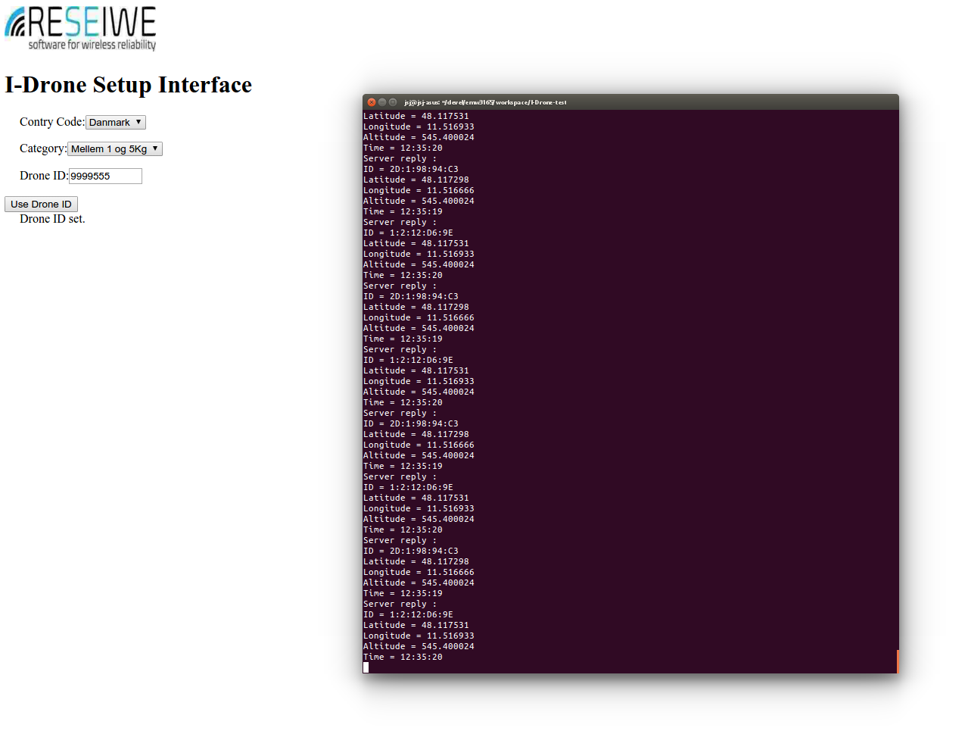
Demo
Prototype til demo
PC interface med tekst udlæsning af position
Kan integreres med kort
Kan integreres i eksisterende udstyr
Rækkevidde
Læser: 2.2 km
Smartphone: Afhængig af antenne i telefon

Slide 4
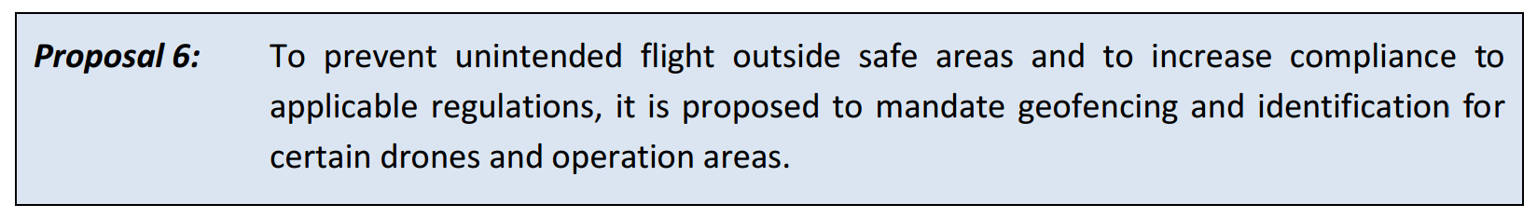
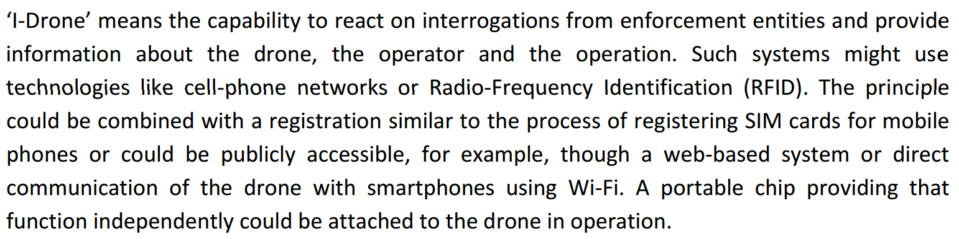
EASA A-NPA 2015-10

Slide 5
ReWiLink (Wi-Fi)
RESEIWE DroneID SW on standard Wi-Fi module
Detect and avoid
ReWiLink (Wi-Fi)
RESEIWE App
ReWiLink (Wi-Fi)
ReWiLink (Wi-Fi)
ReWiLink (Wi-Fi)
RESEIWE Reader
RESEIWE App
GSM
Private
Direct read (smartphone app)
Lookup in database
Police
Direct read
Point and identify (directional reader)
Lookup in database
Pilot
Report to log via GSM (smartphone app)
Storing log for later report if no GSM coverage
Lookup in database
GSM network
Drone flight registration database
Notes:
Wi-Fi: Readable of standard smartphone with App
Reporting App on Pilot phone: Relaying to database
And buffering if no mobile coverage – reporting when within coverage

Slide 6
VDL Mode 4
Detect and avoid
VDL Mode 4
VDL Mode 4
VDL Mode 4
Private
Lookup in database
Police
Direct read
Lookup in database
Pilot
Lookup in database
GSM network
VDL Mode 4 network
Drone flight registration database
Notes:
Wi-Fi: Readable of standard smartphone with App
Reporting App on Pilot phone: Relaying to database
And buffering if no mobile coverage – reporting when within coverage

Slide 7
VDL Mode 4 & ReWiLink
Detect and avoid
VDL Mode 4 & ReWiLink (Wi-Fi)
RESEIWE App
ReWiLink (Wi-Fi)
ReWiLink (Wi-Fi)
VDL Mode 4 & ReWiLink (Wi-Fi)
VDL Mode 4
RESEIWE App
GSM
Private
Direct read (smartphone app)
Lookup in database
Police
Direct read
Point and identify (directional reader)
Pilot
Report to log via GSM (smartphone app)
Storing log for later report if no GSM coverage
Lookup in database
GSM network
VDL Mode 4 network
Drone flight registration database
Notes:
Wi-Fi: Readable of standard smartphone with App
Reporting App on Pilot phone: Relaying to database
And buffering if no mobile coverage – reporting when within coverage

Slide 8
GSM
GSM
GSM
Private
Lookup in database
Police
Lookup in database
Pilot
Lookup in database
GSM network
Drone flight registration database
Notes:
Wi-Fi: Readable of standard smartphone with App
Reporting App on Pilot phone: Relaying to database
And buffering if no mobile coverage – reporting when within coverage

Slide 9
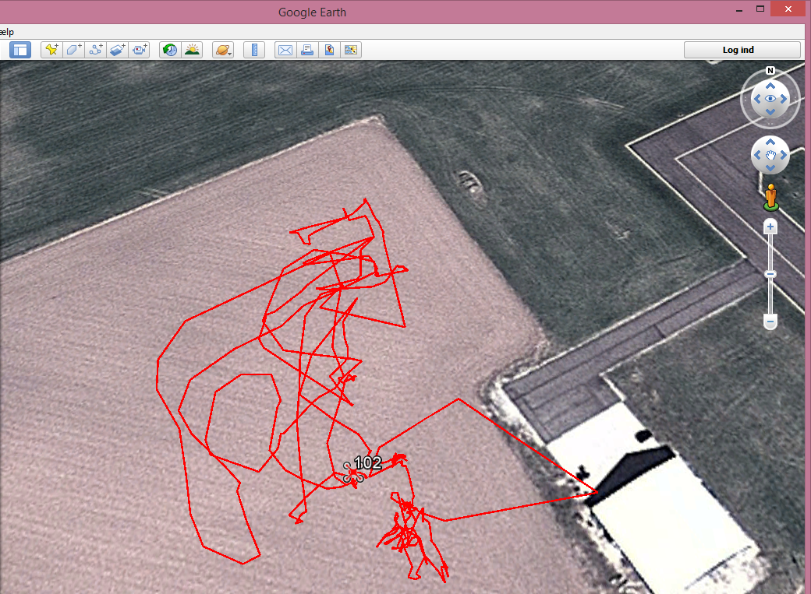
Test flight Dec. 14, 2015
Test flight at HCA Airport, Odense
ReWiLink Drone ID trace
Log via SDU database

